Slide 1
Welcome to
.NET Conf 2023

Slide 2









Build anything with a unified platform
.NET
Cloud
Web
Desktop
Mobile
Gaming
IoT
AI
+
+
Visual Studio
Visual Studio Code
CLI
Linux
NuGet
GitHub
Components, tools, library vendors
Windows
macOS
Tools
Operating system
Ecosystem

Slide 3

.NET Momentum
6.1+ Million
Monthly active users
53,000+
Community members have contributed to .NET
#1 2023
Most Admired Developer Framework
Top 5
Highest velocity OSS project
https://survey.stackoverflow.co/2023/#section-admired-and-desired-other-frameworks-and-libraries
Top 5
https://octoverse.github.com/2022/top-programming-languages
Top Programming Language on GitHub
CNCF (Commits+PRs+Issues)
https://github.com/cncf/velocity/blob/main/reports/top_projects_by_activity.txt

Slide 4
Announcing .NET 8
>21k
> 9 k
Contributions
Community members

Slide 5


Thank You!

Slide 6
Biggest release of .NET yet

Slide 7
Most performant release yet
Performance-related improvements
1250+
250+
550+
1000+
.NET 5
.NET 6
.NET 7
.NET 8
https://devblogs.microsoft.com/dotnet/performance-improvements-in-net-8/

Slide 8


.NET 8 API Performance
JSON
Fortunes
1M
350K
300K
+24%
800K
+18%
250K
600K
200K
400K
150K
100K
200K
50K
0K
.NET 7
.NET 8
0
.NET 7
.NET 8
Source: aka.ms/aspnet/benchmarks
Requests per Second (higher is better)

Slide 9



.NET is the best for modern apps
Modern
Workloads
Web
Client
Artificial Intelligence
Cloud Native
Developer
Productivity
Language
Productivity
Modernization
Fundamentals
Performance
Supply Chain

Slide 10
Web
Client
Artificial Intelligence
Cloud Native

Slide 11
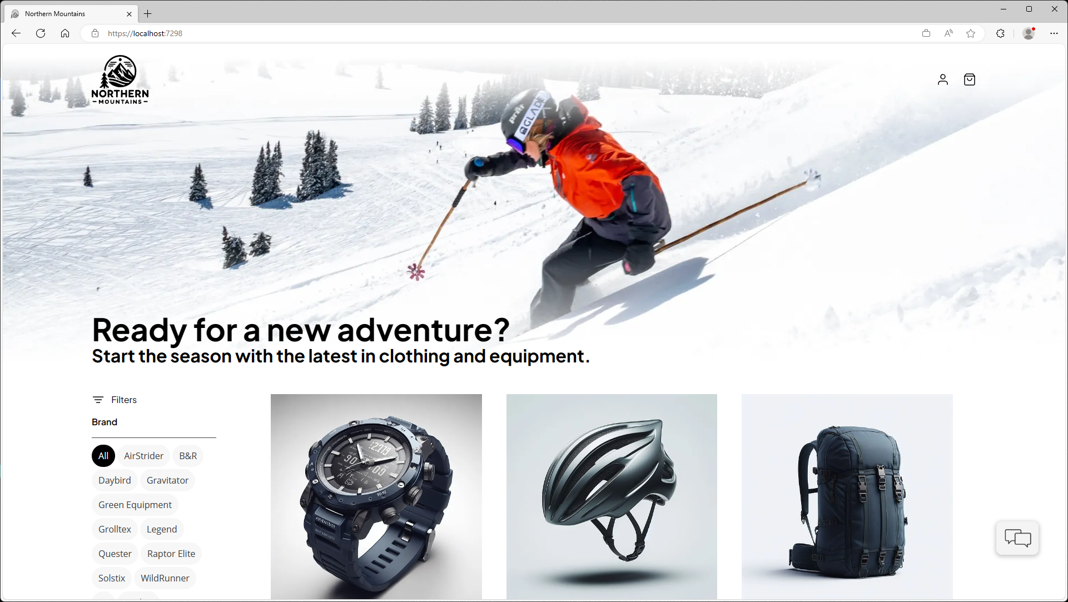

Slide 12





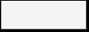





Cloud Services
Client Apps
Identity Service
Mobile BFF
Identity API
PostgreSQL
Mobile App
OpenAI
Mobile API
Catalog Service
Catalog API
PostgreSQL
Order Service
Ordering API
Web App
Ordering API
Order Processor
PostgreSQL
Event Bus
Browser
Blazor App
Basket Service
Basket API
Redis
Payment Service
Payment Processor
Admin Services
Webhook Client
Webhooks Service
Observability
Webhooks API
PostgreSQL

Slide 13
ASP.NET Core
Full Stack Web Apps

Slide 14
Your Full Stack Web Platform with .NET
Web UI
APIs
Data
Server
Security
Tooling

Slide 15
Full stack web UI with Blazor
Server
Server & Client
Client
Static server rendering
Enhanced navigation & form handling
Streaming rendering
Enable interactivity per component or page
Auto select the render mode at runtime

Slide 16
Blazor in .NET 8
Faster WebAssembly
New components
20% faster UI rendering
Display data with QuickGrid
Hot Reload improvements
Section outlets
Web-friendly packaging
Authentication & identity

Slide 17
.NET APIs
Performance
Productivity
Developer Experience

Slide 18
Demo
Full Stack web UI with Blazor

Slide 19
ASP.NET Core improvements in .NET 8
Full stack web UI
Security & APIs
Runtime
Static server rendering
Simplified auth for SPA
HTTP/3
Enhanced navigation & form handling
Identity endpoints
Native AOT
Streaming rendering
Token based support
Request timeouts
Interactivity per component or page
Simplified custom authorization policies
Route short-circuits
Faster app load with Auto render mode
Anti-forgery
Metrics
Route tooling
Named pipes
Endpoints explorer

Slide 20
Check out ASP.NET Core sessions
Full stack web UI with Blazor in .NET 8
Performance Improvements in .NET 8, ASP.NET Core, and .NET MAUI
In .NET 8, ASP.NET Ate

Slide 21
Client App Development

Slide 22

.NET Multi-platform App UI (MAUI)
Single project system, single codebase
macOS
iOS
WinUI
Mac Catalyst
iOS
Android

Slide 23
.NET MAUI in .NET 8
Performance
Quality
Ecosystem
Hybrid Apps
Developer Experience

Slide 24
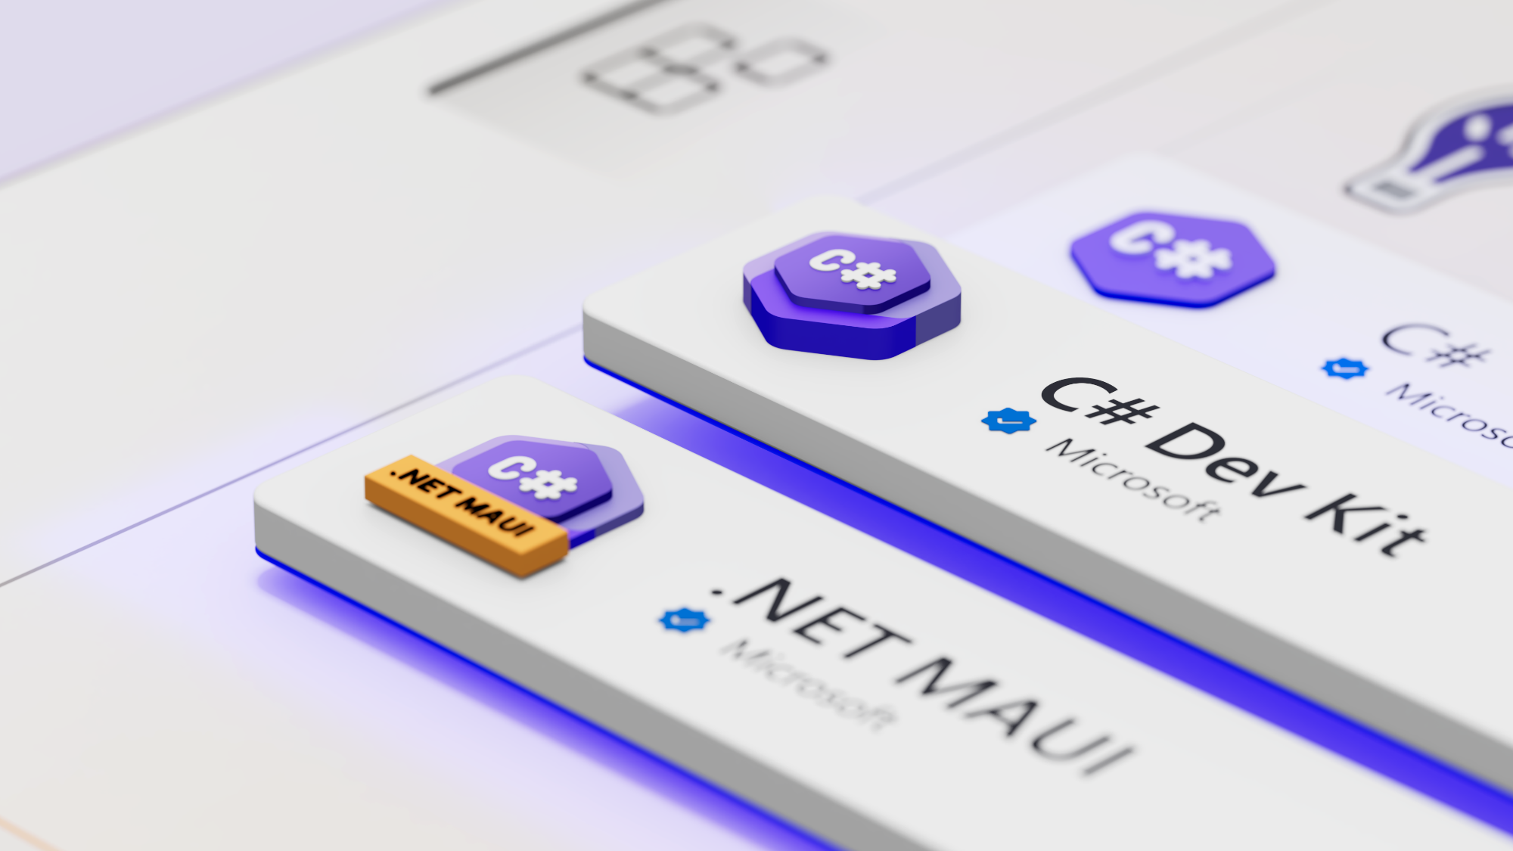
aka.ms/csdevkit
aka.ms/mauidevkit

Slide 25
Demo
.NET MAUI

Slide 26

















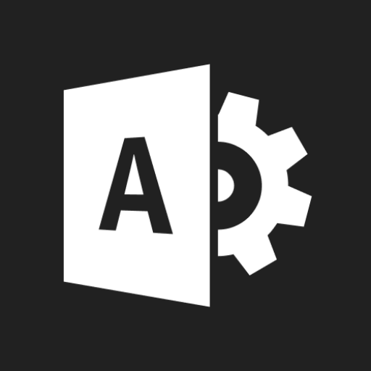










Slide 27
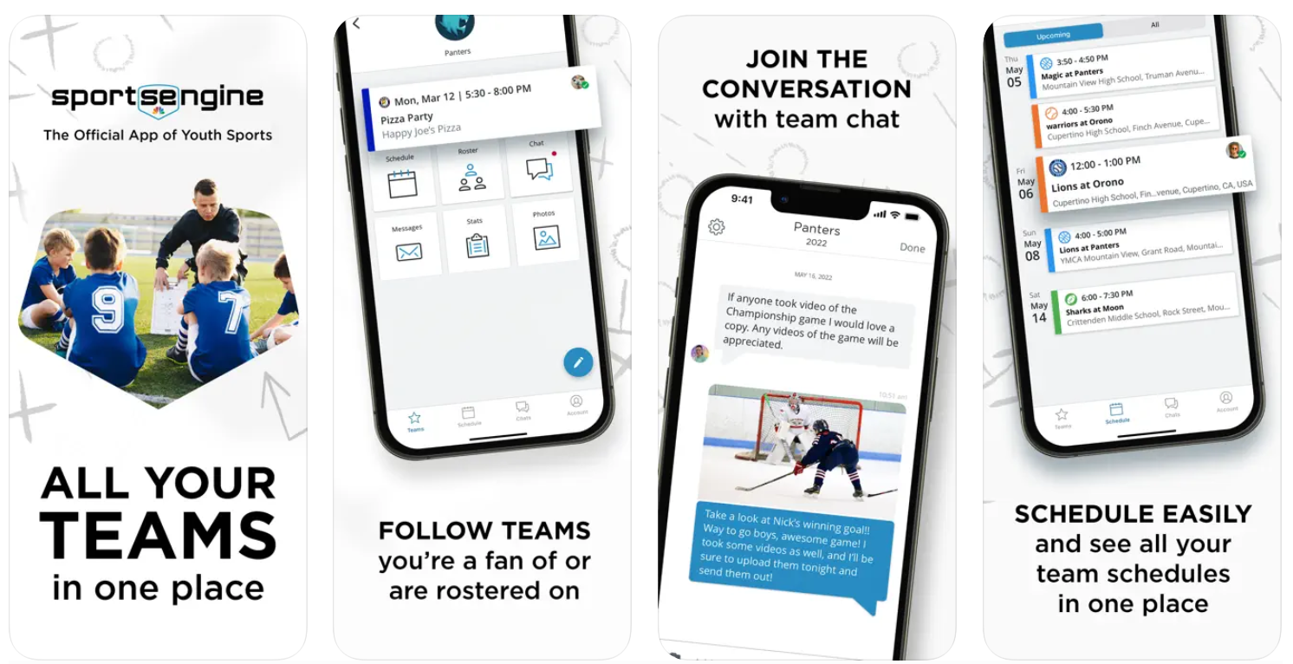
NBC Sports - Video

Slide 28
Artificial Intelligence
Leveraging Large Language Models and Generative AI in .NET

Slide 29
Artificial Intelligence
Transform your .NET Applications with AI Today
.NET 💖 AI
Out of the box AI features
Easy to get started with Azure Open AI and Azure Cognitive Search SDKs
Large Language Model integration with Semantic Kernel
Fast growing AI ecosystem

Slide 30
Demo
Artificial Intelligence

Slide 31
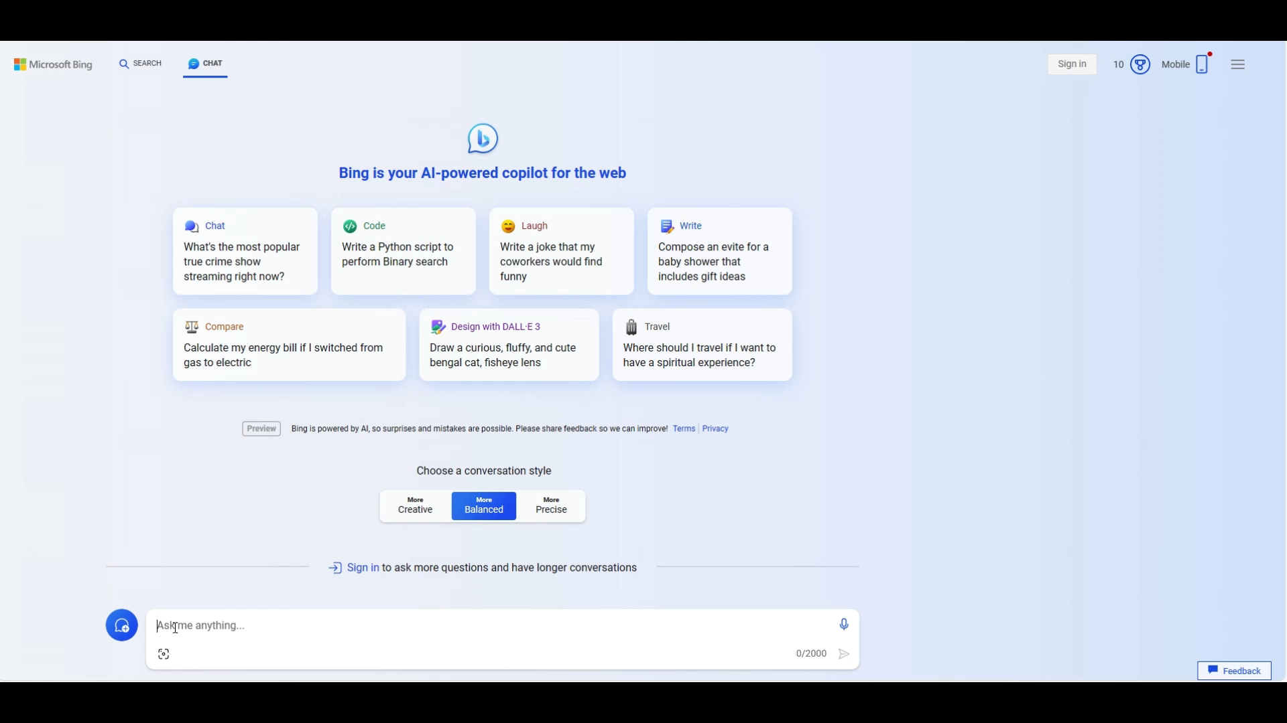
Microsoft AI experiences
Powered by .NET

Slide 32


“C# and .NET are the go-to language and framework for our software development organization. Not only do they allow us to build highly scalable applications and websites like stackoverflow.com, but with all the excellent tooling available, they support the entire development lifecycle from rapid prototyping and iteration to alpha to full-fledged product offerings like our OverflowAI product.”
Ben Matthews
Director Of Engineering
Stack Overflow

Slide 33

Intel oneDAL
“Our partnership with Microsoft showcases Intel's commitment to empower .NET developers in incorporating AI seamlessly into their applications. By integrating the Intel oneAPI Data Analytics Library (oneDAL) with .NET, we're making it straightforward for developers to tap into accelerated AI and ML capabilities.”
Wei Li
VP, General Manager for Datacenter AI Solutions
Intel

Slide 34
Cloud Native

Slide 35
Cloud Native
Observability
Resiliency
Scalability
Manageability

Slide 36
High-scale and high-availability
services in .NET 8
Resilience
Health Checks
Testing/Fakes
Observability
Extensions.Resilience
Extensions.Compliance.Redaction
Extensions.Http.Resilience
Extensions.Http.Telemetry
Extensions.Diagnostics.HealthChecks.Common
AspNetCore.Testing
Extensions.Diagnostics.Probes
Hosting.Testing
Extensions.Telemetry
Extensions.TimeProvider.Testing

Slide 37
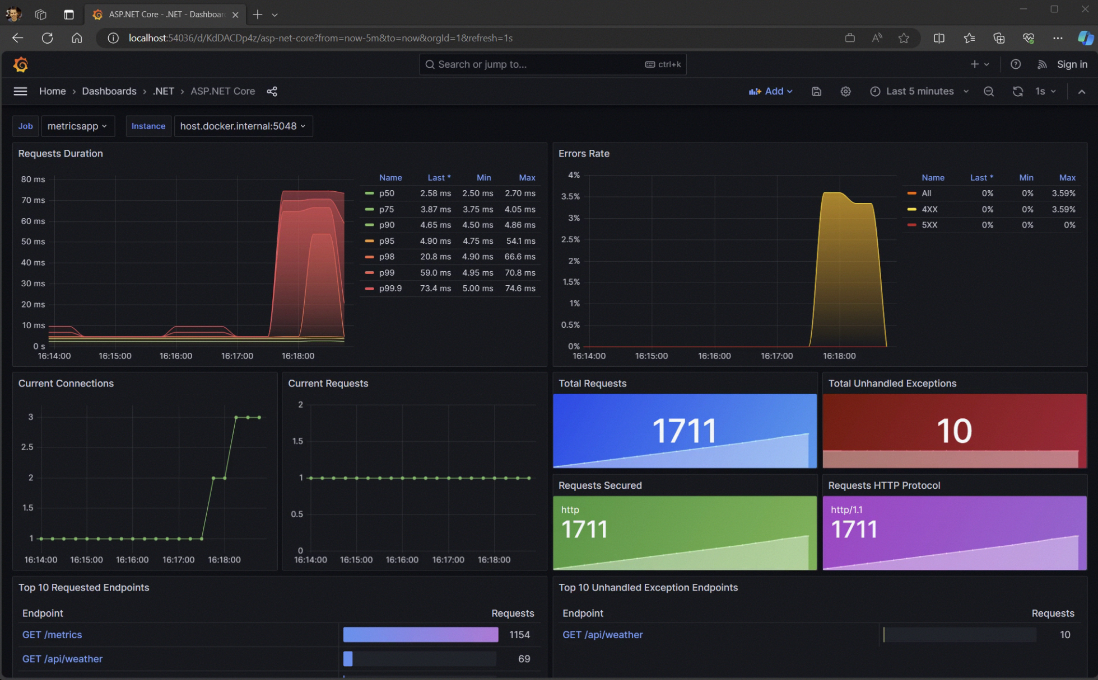
Enhanced Open Telemetry Support
https://youtu.be/8PAZmpEQYqc

Slide 38
Containers

Slide 39
.NET💜Containers
Hardened
Smaller
More Productive
Non-Root Base Images
AOT base images
Publish with .NET SDK
USER "app"
"Composite" base images
Cross compilation
Default port - 8080
"extra" base images
Non-root by default
Mariner distroless
Distroless / Chiseled
Supports all Azure auth

Slide 40
Container Size Improvements
Optimizations
Compressed (MB)
Uncompressed (MB)

Slide 41
Native AOT

Slide 42



Before Native AOT
95 MB
87 MB
142ms
809K
97 MB
83 MB
309ms
746K
Published Size
Working Set
Startup
RPS
Published Size
Working Set
Startup
RPS
Linux
Windows

Slide 43
Native AOT in .NET 8
724K
706K
55 MB
40 MB
74ms
9.97 MB
34ms
8.87 MB
Published Size
Working Set
Startup
RPS
Published Size
Working Set
Startup
RPS
Linux
Windows

Slide 44
DEMO
AOT in .NET 8

Slide 45

Vestas Wind Systems
“Through our wind energy and hybrid projects, we have kept 1.9 billion cubic tons of CO2 out of the atmosphere.
The cloud-native capabilities of .NET effortlessly orchestrate our workloads, requiring 400,000 cores and petabytes of data. It is a natural fit for our high-performance computing…”
Yavor Hristov, Ph.D.
Plant Data & Optimization
Vestas Wind Systems

Slide 46
Cloud Native in .NET 8
Observability
Resiliency
Scalability
Manageability
Built in metrics with dimensions
New Polly based resiliency packages
AOT (increased density)
Certificate auto-rotation support in Kestrel
DI integration for metrics
SignalR Stateful Reconnect
Performance
Better Logging support (faster, can object serialization)
Chiseled Ubuntu
Enrichment
Redaction
Testing fakes for Logging & Metrics

Slide 47
We heard from you
“It’s not just that I have too many Lego bricks to choose from, I’m not sure I’m even putting the Lego blocks together correctly.”
“Every developer on my team now needs to be an expert in networking, containers, telemetry systems, etc.
It never used to be that way and it slows down everything we do.”
“Nothing works together by default.”

Slide 48
Cloud Native
Problems to solve
Complex
Getting Started
Choices
Paved Path

Slide 49
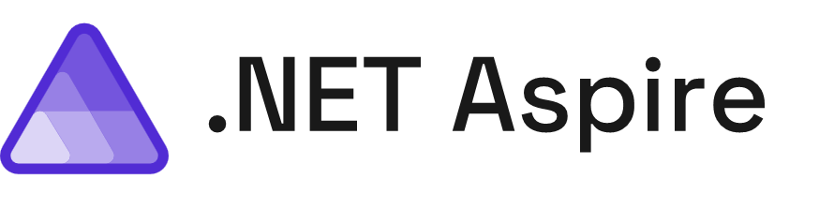
A cloud ready stack for building observable, production ready, distributed applications

Slide 50
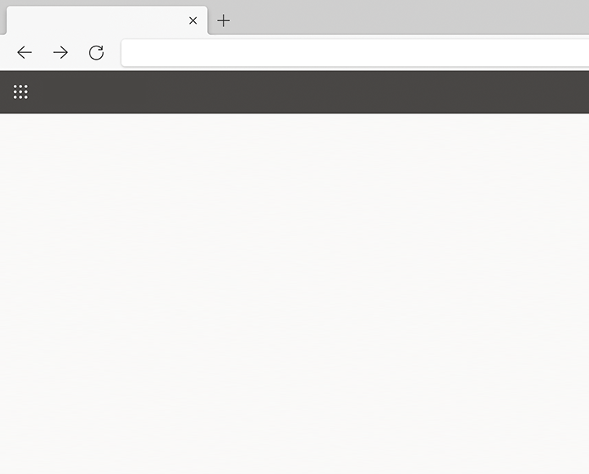


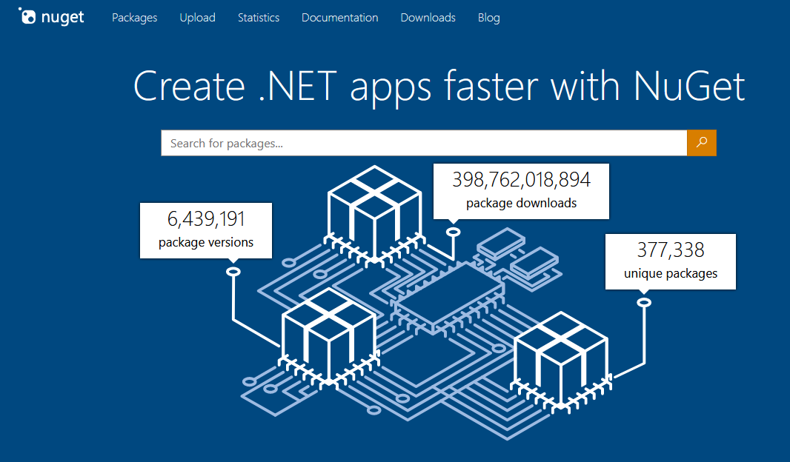




Components
Nuget Gallery | Home
https://www.nuget.org

Slide 51
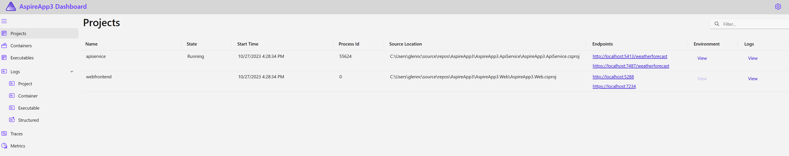
Developer Dashboard
AspireApp
https://localhost:7298
Structured Logs
Metrics
Distributed Traces
Dependencies

Slide 52
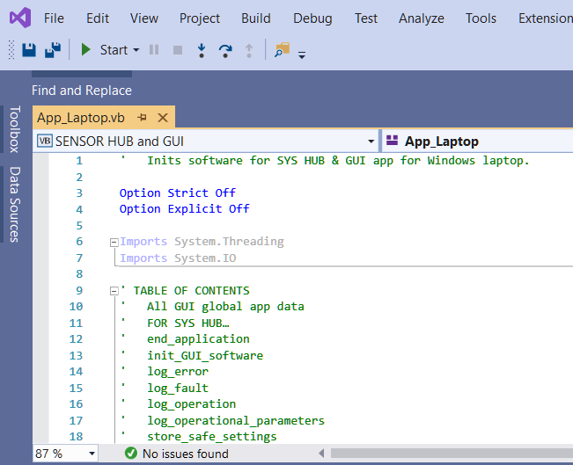
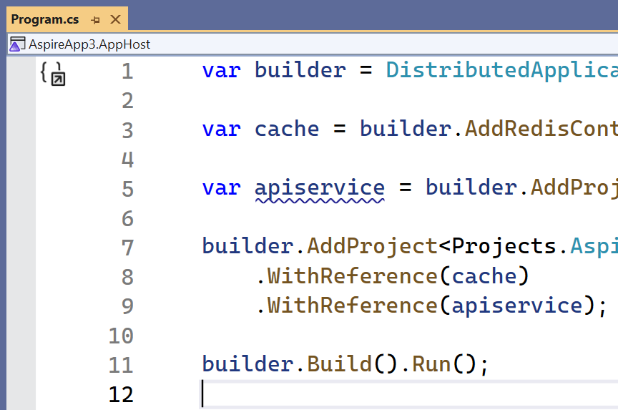
Single command operation
Express application topology in C#
Deploy to the cloud

Slide 53
DEMO
.NET Aspire

Slide 54
First Preview Available Today
Engage with team on GitHub
aka.ms/dotnet-aspire
github.com/dotnet/aspire

Slide 55
Web
Client
Artificial Intelligence
Cloud Native

Slide 56
Get .NET 8
Download .NET 8 aka.ms/get-dotnet-8

Slide 57
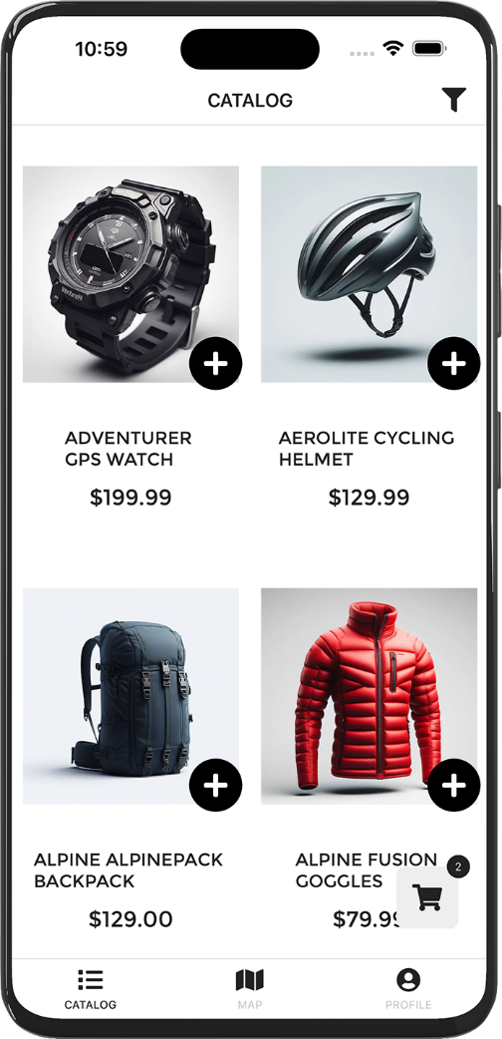
eShop Architecture Sample
github.com/dotnet/eshop

Slide 58
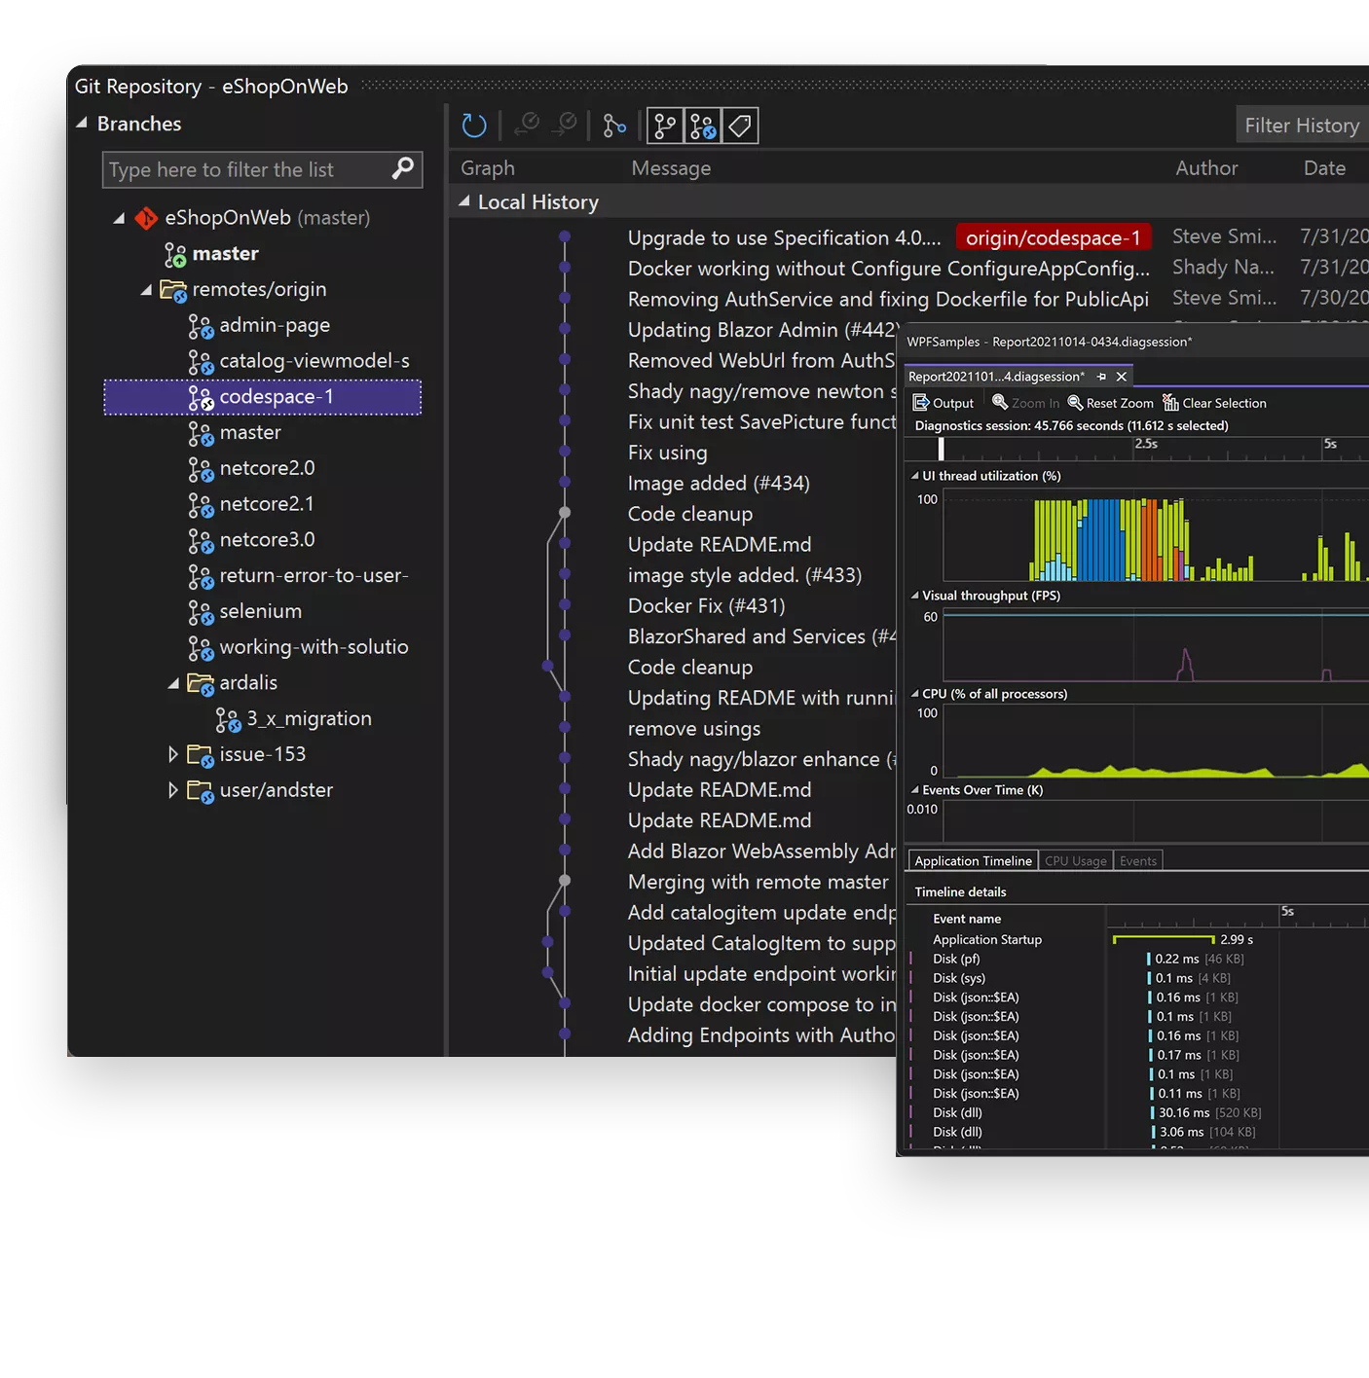
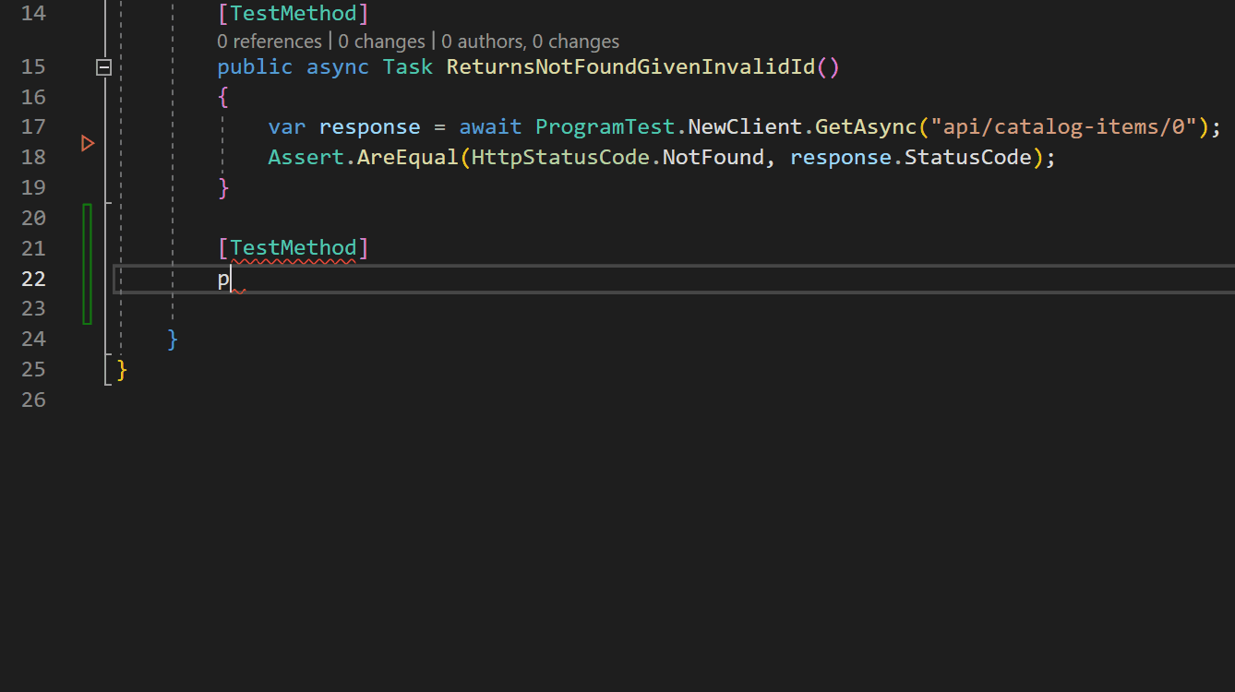
Visual Studio 2022 v17.8 GA
Released
Modern development for .NET 8 using WSL2
GitHub Copilot boosts your developer output with AI
Improved collaboration, add reviews to pull requests
visualstudio.com/download

Slide 59


Slide 60

Microsoft Learn for .NET
aka.ms/learndotnet

Slide 61
Thank you!

